Slide 1

DATA ANALYTICS PROJECT
Population Growth Analysis
and Forecasting
A 65-Year Global Study of Population Trends, Growth Patterns, and Future Projections (1960–2024)
Course: Introduction to Data Analytics
Presented by: Pranav Sukhadev Phadtare Akunuru Abhishek Karthik
Instructor: Dr. Sami Ur Rahman
Notes:
Welcome the audience. Introduce the project: a full data analytics study of global population growth from 1960-2024, covering cleaning, analysis, visualization, and forecasting. Mention team names and course. Keep this to about 30 seconds.

Slide 2
OVERVIEW
What We'll Cover
01
Dataset Overview
02
Data Cleaning
03
Methodology
04
Key Findings
05
Advanced Analysis
06
Forecasting
07
Insights & Challenges
Population Growth Analysis and Forecasting
2
Notes:
Quickly walk through the agenda so the audience knows what's coming: dataset, cleaning, methodology, key findings, advanced analysis, forecasting, and insights/challenges. About 20-30 seconds.

Slide 3
SECTION 1
Dataset Overview
World Bank — Population, Total (SP.POP.TOTL)
De facto total population by country, reported annually — data.worldbank.org/indicator/SP.POP.TOTL
198
65
12,870
6
Countries & Territories
Years of Data (1960–2024)
Country-Year Records
Continents Covered
Required Fields Collected
Why This Dataset
Country / region name
Clears the project minimums (50+ countries, 30+ years) by a wide margin
Year
Authoritative, current, and freely available
Population
Comes with a continent grouping built in
Continent / region category
Spans enough time to model long-term trends
Population Growth Analysis and Forecasting
3
Notes:
Explain the dataset: World Bank's Population, Total indicator (SP.POP.TOTL), 198 countries, 65 years (1960-2024), 12,870 country-year records after cleaning. Note it exceeds the project's minimum of 50 countries / 30 years by a wide margin. Mention it includes continent grouping which enables comparative analysis later.

Slide 4
SECTION 2
Data Cleaning & Preprocessing
1
2
3
4
Reshape
Fix Values
De-duplicate
Engineer Features
Melted wide-format columns (one per year) into a tidy long format with Country, Year, Population
Removed commas, coerced to numeric, dropped rows missing Country / Year / Population
Removed duplicate rows and standardized country name formatting (USA → United States, etc.)
Added Annual Change, Growth Rate %, Decade, and Growth Category columns
Result: A clean dataset of 12,870 country-year records with zero missing values in the core analytical fields — saved as Cleaned_Population_Data.csv
Population Growth Analysis and Forecasting
4
Notes:
Walk through the four cleaning stages: (1) reshaped wide-format data into long format using pandas melt, (2) fixed numeric formatting and dropped missing values, (3) removed duplicates and standardized country names like USA -> United States, (4) engineered new columns: Annual Change, Growth Rate %, Decade, Growth Category. End with the result: a clean 12,870-row dataset with zero missing values in core fields.

Slide 5


SECTION 3
Methodology & Tools
Tools Used
Workflow Snapshot
pandas
Data loading, cleaning, reshaping, aggregation
df = df.melt(id_vars=['Country','Continent'],
var_name='Year', value_name='Population')
df['Growth Rate (%)'] = df.groupby('Country')
['Population'].pct_change() * 100
model = LinearRegression().fit(X, y)
future_pred = model.predict(future_years)
NumPy
Numerical operations for statistical calculations
Matplotlib / Seaborn
Chart generation — line, bar, pie, scatter, heatmap
scikit-learn
Linear regression for population forecasting
Stages: Collect → Clean → Explore → Advanced Analysis → Visualize → Forecast
Population Growth Analysis and Forecasting
5
Notes:
Briefly mention the Python toolchain: pandas for data wrangling, NumPy for numeric work, Matplotlib/Seaborn for charts, scikit-learn for the forecasting model. Point to the code snippet as a quick demonstration of the actual workflow -- the melt() reshape, the growth rate calculation, and the linear regression call. This satisfies the 'short demonstration of code' requirement.

Slide 6
SECTION 4 — KEY FINDINGS
Who Leads Global Population? (2024)
1.45B
India — Largest
4,607
Nauru, 1960 — Smallest ever
7.84B
World Total, 2024
Population Growth Analysis and Forecasting
6
Notes:
India is now the world's most populous country at 1.45B, just ahead of China at 1.41B. Point out the steep drop-off after the top two -- the US is a distant third at 340M. Mention Nauru's 4,607 people in 1960 as the smallest population ever recorded in the dataset, and that the world total is 7.84 billion as of 2024.

Slide 7

SECTION 4 — KEY FINDINGS
Global Population Distribution (2024)
Reading the Split
India and China together hold over a third of the world's people — 36.5%, to be exact
Add in the next three biggest countries and the top 5 account for 47.6% of everyone alive
The other 193 countries and territories split the remaining 52.4%
In short: population is concentrated in a surprisingly small number of nations
Population Growth Analysis and Forecasting
7
Notes:
India and China together hold over a third of humanity. The top 5 countries combine for 47.6%, meaning the other 193 countries share roughly half the world's population. This sets up the later point about absolute vs relative growth.

Slide 8
SECTION 4 — KEY FINDINGS
Growth Analysis: Countries & Continents
Top 10 Countries by Avg. Growth Rate
Average Growth Rate by Continent
Population Growth Analysis and Forecasting
8
Notes:
Left chart: the fastest-growing countries are small Gulf states (UAE, Qatar) driven by labor migration, not births. Right chart: by continent, Africa (2.46%) and Asia (2.33%) lead, while Europe (0.52%) trails far behind -- consistent with Europe's aging population story.

Slide 9
SECTION 4 — KEY FINDINGS
Growth Extremes & Negative Growth
Highest Growth
Qatar, 2007
+24.23%
Lowest Growth
Kuwait, 1990
–24.02%
Population Growth Analysis and Forecasting
9
Notes:
Rwanda's chart reflects the 1994 genocide and its demographic aftermath; Kuwait and Liberia reflect war-driven population displacement. Contrast this with the highest-ever single year, Qatar 2007 (+24.23%), driven by a construction and energy worker boom, versus the lowest, Kuwait 1990 (-24.02%), tied to the Gulf War.

Slide 10


SECTION 5 — ADVANCED ANALYSIS
Outliers & Long-Term Growth Ranking
Top Growth Outliers (IQR Method)
Top Long-Term Growth (1960–2024)
Country | Year | Rate
Qatar | 2007 | 24.23
Kuwait | 1990 | -24.02
Macao SAR, China | 1964 | 23.89
Seychelles | 2022 | 20.77
United Arab Emirates | 1969 | 20.18
Rwanda | 1996 | 18.23
Oman | 2012 | 15.29
Northern Mariana Islands | 1982 | 12.73
Country | Added | Growth %
India | 1,014,945,453 | 232.79%
China | 741,905,000 | 111.22%
Pakistan | 205,559,854 | 449.71%
Indonesia | 195,191,861 | 221.07%
Nigeria | 187,625,696 | 416.45%
United States | 159,439,988 | 88.25%
Brazil | 139,610,447 | 192.86%
Bangladesh | 121,733,704 | 234.88%
India added over 1 billion people since 1960 — more than any other country — while Ethiopia (+518%) and Pakistan (+450%) grew fastest in percentage terms. Outliers cluster around two causes: labor-driven immigration into small Gulf states, and population shocks from conflict or political upheaval.
Population Growth Analysis and Forecasting
10
Notes:
We used the IQR method to flag statistical outliers in growth rate. Two patterns emerge: Gulf-state migration booms (Qatar, UAE, Oman) and conflict-driven shocks (Kuwait, Rwanda, Ukraine). On the right, ranking by total population added since 1960, India leads with over a billion people added -- more than any other country -- while smaller economies like Ethiopia and Pakistan grew fastest in percentage terms.

Slide 11
SECTION 5 — ADVANCED ANALYSIS
Population Doubling Time (Rule of 70)
What It Means
Ethiopia, Pakistan, and Nigeria would double in roughly 25–27 years if their current rates held
India and Indonesia land around 37–39 years
China's slower growth stretches that out to about 60 years
Russia's growth is so close to flat that the math says 250 years — which really just means a stable population
Population Growth Analysis and Forecasting
11
Notes:
Using the Rule of 70, we estimate how long each of the 10 most populous countries would take to double at their historical growth rate. Ethiopia, Pakistan, and Nigeria would double in roughly 25-27 years. Russia's near-zero growth implies a 250-year doubling time -- essentially a stable, non-growing population.

Slide 12
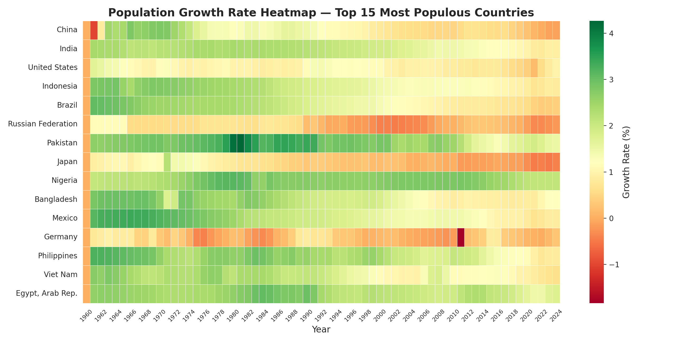
SECTION 5 — ADVANCED ANALYSIS
Growth Rate Patterns Over Time
Population Growth Analysis and Forecasting
12
Notes:
This heatmap shows growth rate per year for the 15 most populous countries. Notice the long-run regimes rather than noise: Nigeria and Pakistan stay green (high growth) for decades; Germany and Japan visibly drift from green to orange/red over time; Russia's growth collapses into red after 1990, coinciding with the Soviet collapse.

Slide 13
SECTION 6 — FORECASTING
Population Forecast for India (2025–2034)
2025 → 2034
1.48B → 1.63B
Model Limitations:
Assumes constant growth rate
Ignores migration & policy shifts
Accuracy decreases over time
Can't predict shocks (pandemics, conflict)
Linear regression trained on India's 1960–2024 population, projected 10 years forward.
Population Growth Analysis and Forecasting
13
Notes:
We trained a simple linear regression on India's 1960-2024 population and projected 10 years forward. The model forecasts growth from about 1.48 billion in 2025 to 1.63 billion in 2034. Be upfront about limitations: it assumes constant growth, ignores migration and policy changes, and can't anticipate shocks like pandemics or conflict -- explain why we still consider it a reasonable short-term estimate.

Slide 14

SECTION 7
Main Findings
Slowing Growth
India Leads
Africa Rising
The world's population keeps climbing, but it's adding people more slowly than it used to.
India has overtaken China as the most populous country, and China's growth has dropped to near zero.
Africa now has the highest average growth rate of any continent, at 2.46%.
Europe Aging
Volatility is Local
Absolute vs. Relative
Europe's growth rate, just 0.52%, is the lowest anywhere — no surprise given its aging population.
The wildest growth swings happen in small Gulf states or conflict zones, not in large countries.
India and China add the most people; Ethiopia and Pakistan grow the fastest in percentage terms.
Population Growth Analysis and Forecasting
14
Notes:
Summarize the six main takeaways: growth is slowing globally even as totals rise; India now leads in population; Africa has the highest regional growth rate; Europe has the lowest; volatility is concentrated in small or conflict-affected countries, not major economies; and absolute growth leaders (India, China) differ from relative growth leaders (Ethiopia, Pakistan).

Slide 15
SECTION 7
Challenges Faced
Getting the wide-format World Bank data (one column per year) into a clean long format took some care — melt() and type coercion don't always behave the way you expect on the first try.
Small territories with tiny populations can swing to huge percentage growth rates from a handful of people moving — we had to watch for that distorting the 'top outlier' rankings.
Country names and borders shifted over 65 years (German reunification, the USSR breaking up), which left a few minor gaps and discontinuities in the historical numbers.
A simple linear model can't really capture how fertility actually declines as a country develops, so our long-range forecast accuracy has real limits.
Population Growth Analysis and Forecasting
15
Notes:
Be honest about what was hard: reshaping the wide-format World Bank export took careful handling; tiny territories produced misleading percentage outliers; historical border/name changes (German reunification, USSR dissolution) created small data discontinuities; and a simple linear model can't capture real demographic transitions, which limits how far out we can forecast reliably.

Slide 16

CONCLUSION
The world keeps growing — but unevenly.
From 2.95 billion in 1960 to 7.84 billion in 2024 — growth has slowed across developed economies even as it picks up, proportionally, across Africa and South Asia. India now leads the world in population, and the next decade looks set to bring more of the same: steady, if moderate, growth.
Thank You
Questions & Discussion
Population Growth Analysis and Forecasting
16
Notes:
Close with the core message: the world keeps growing, but unevenly -- slowing in developed economies, accelerating proportionally in Africa and South Asia, with India now the world's most populous nation. Thank the audience and open the floor for questions.

